Slide 1
Introduction to algorithms

Slide 2
Contents
Fundamentals of algorithmic problem solving
Analysis Framework
Asymptotic Notation
Basic Efficiency classes
Mathematical Analysis of Recursive & Non recursive algorithms

Slide 3
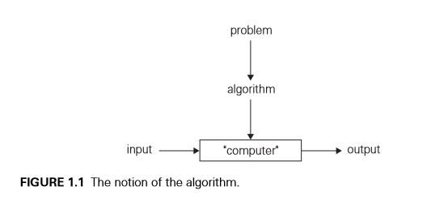
Fundamentals of algorithmic problem solving
An algorithm is a sequence of unambiguous instructions for solving a problem, i.e., for obtaining a required output for any legitimate input in a ﬁnite amount of time.
The non ambiguity requirement for each step of an algorithm cannot be compromised.
The range of inputs for which an algorithm works has to be speciﬁed carefully.
The same algorithm can be represented in several different ways.
There may exist several algorithms for solving the same problem.
Algorithms for the same problem can be based on very different ideas and can solve the problem with dramatically different speeds.

Slide 4
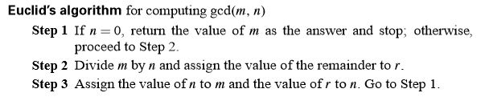
Fundamentals of algorithmic problem solving
Pseudocode:
ALGORITHM Euclid(m, n)
//Computes gcd(m, n) by Euclid’s algorithm
//Input: Two nonnegative, not-both-zero integers m and n
//Output: Greatest common divisor of m and n
while (n!= 0) do
r ←m mod n
m←n
n←r
End while
return m

Slide 5
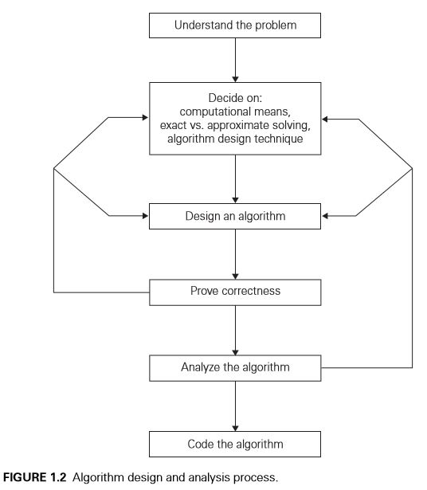
Algorithmic Design and Analysis Process

Slide 6
Algorithmic Design and Analysis Process : Steps
Understanding the Problem
Ascertaining the Capabilities of the Computational Device: Sequential, Parallel
Choosing between Exact and Approximate Problem Solving :
Choose between solving the problem exactly (Exact algorithm) or solving it approximately (approximation algorithm)
Algorithm Design Techniques
An algorithm design technique (or “strategy” or “paradigm”) is a general approach to solving problems algorithmically that is applicable to a variety of problems from different areas of computing.
Designing an Algorithm and Data Structures: Arrays, Linked Lists, Queue, Stack
Methods of Specifying an Algorithm : Flow Chart, Pseudo code, Algorithm
Proving an Algorithm’s Correctness : Tracing using paper and pen method
Analyzing an Algorithm : Time Efficiency, Space Efficiency
Coding an Algorithm: Using C++, Java, Python programming languages etc.

Slide 7
Important Problem Types
Sorting
Searching
String processing
Graph problems
Combinatorial problems
Geometric problems
Numerical problems

Slide 8
The Analysis Framework
Time efﬁciency: Time Efficiency also called time complexity, indicates how fast an algorithm in question runs.
Space efﬁciency: Space Efficiency is also called space complexity, refers to the amount of memory units required by the algorithm in addition to the space needed for its input and output.
T (n)≈ CopC(n)
Where
Let Cop be the execution time of an algorithm’s basic operation on a particular computer,
let C(n) be the number of times this operation needs to be executed for this algorithm.

Slide 9
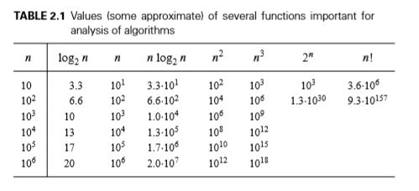
Order of Growth

Slide 10
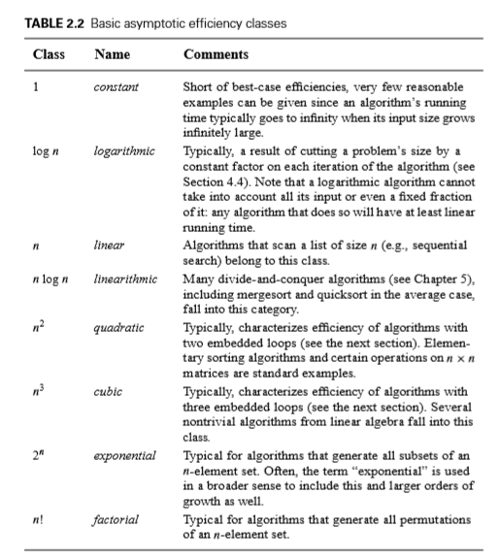
Basic Efficiency Classes

Slide 11
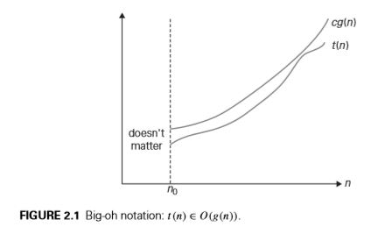
Asymptotic Notations
O-notation DEFINITION: A function t(n) is said to be in O(g(n)), denoted t(n)∈O(g(n)), if t(n) is bounded above by some constant multiple of g(n) for all large n, i.e., if there exist some positive constant c and some nonnegative integer n0 such that t(n)≤cg(n) for all n≥n0.
Ex 1:100n+5≤105n (for all n≥n0)
Ex2: 100n+5≤101n (for all n≥n0

Slide 12
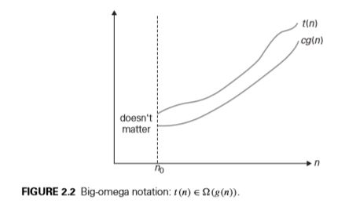
Asymptotic Notations
Ω-notation DEFINITION : A function t(n) is said to be in (g(n)), denoted t(n)∈ Ω(g(n)), if t(n) is bounded below by some positive constant multiple of g(n) for all large n, i.e., if there exist some positive constant c and some nonnegative integer n0 such that t(n)≥cg(n) for all n≥n0.

Slide 13
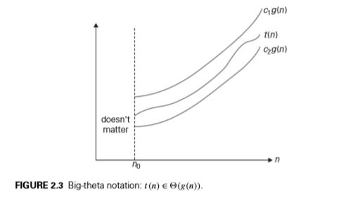
Asymptotic Notations
Θ-notation DEFINITION :A function t(n) is said to be in (g(n)), denoted t(n)∈Θ (g(n)), if t(n) is bounded both above and below by some positive constant multiples of g(n) for all large n, i.e., if there exist some positive constants c1 and c2 and some nonnegative integer n0 such that c2g(n)≤t(n)≤c1g(n) for all n≥n0

Slide 14
THEOREM:
THEOREM:
If t1(n)∈O(g1(n)) and t2(n)∈O(g2(n)), then t1(n)+t2(n)∈O(max{g1(n), g2(n)}).
Proof: t1(n)≤c1g1(n) for all n≥n1.
t2(n)≤c2g2(n) for all n≥n2.
t1(n)+t2(n)≤c1g1(n)+c2g2(n)
Let c3=max{c1,c 2} and consider n≥max{n1,n 2}, we can write ≤c3g1(n)+c3g2(n)
=c3[g1(n)+g2(n)]
≤c3max{g1(n), g2(n)}.

Slide 15

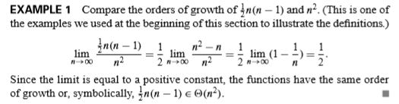
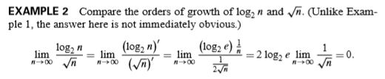
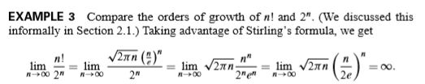
Comparing Orders of Growth using limits

Slide 16
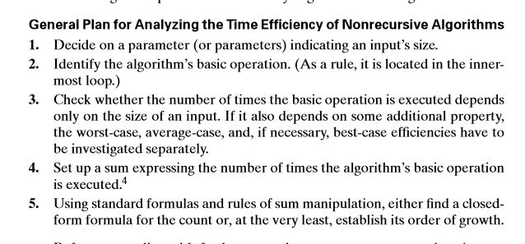
Analysis of Non recursive Algorithms

Slide 17

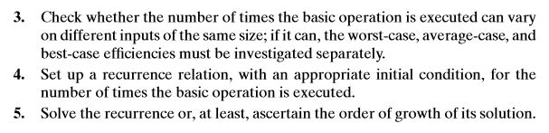
Analysis of Recursive Algorithms

Slide 18
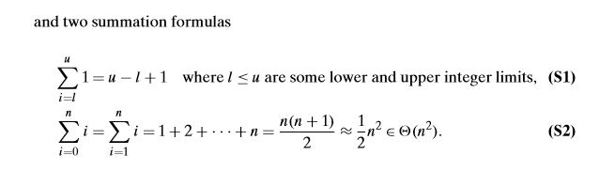
Summation formulas used for non recursive algorithms analysis

